Slide 1
ROC Curves and Operating Points
Geoff Hulten

Slide 2
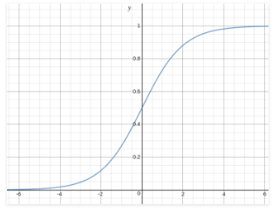
Classifications and Probability Estimates
Logistic regression produces a score (probability estimate)
Use threshold to produce classification
What happens if you vary the threshold?

Slide 3
Example of Changing Thresholds
 | Threshold = .5
False Positive Rate | 33%
False Negative Rate | 0%
Score | Prediction | Y
.25 |  | 0
.45 |  | 0
.55 |  | 1
.67 |  | 0
.82 |  | 1
.95 |  | 1
 | Threshold = .6
False Positive Rate | 33%
False Negative Rate | 33%
 | Threshold = .7
False Positive Rate | 0%
False Negative Rate | 33%

Slide 4
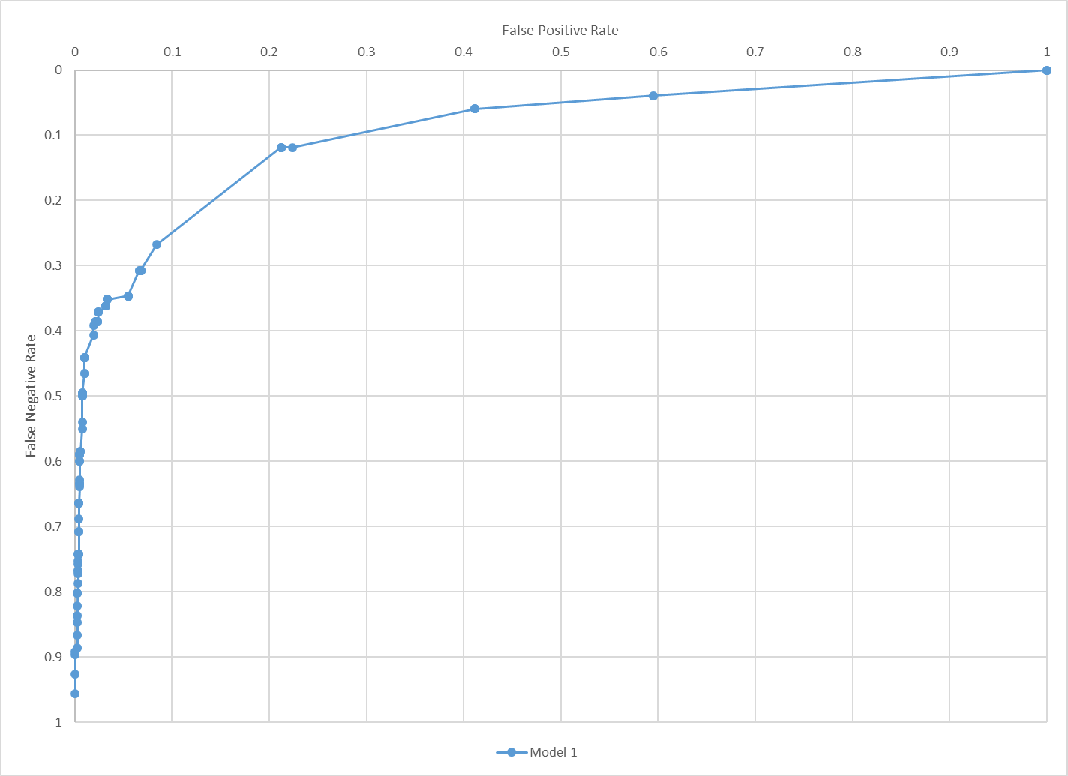
ROC Curve

Slide 5
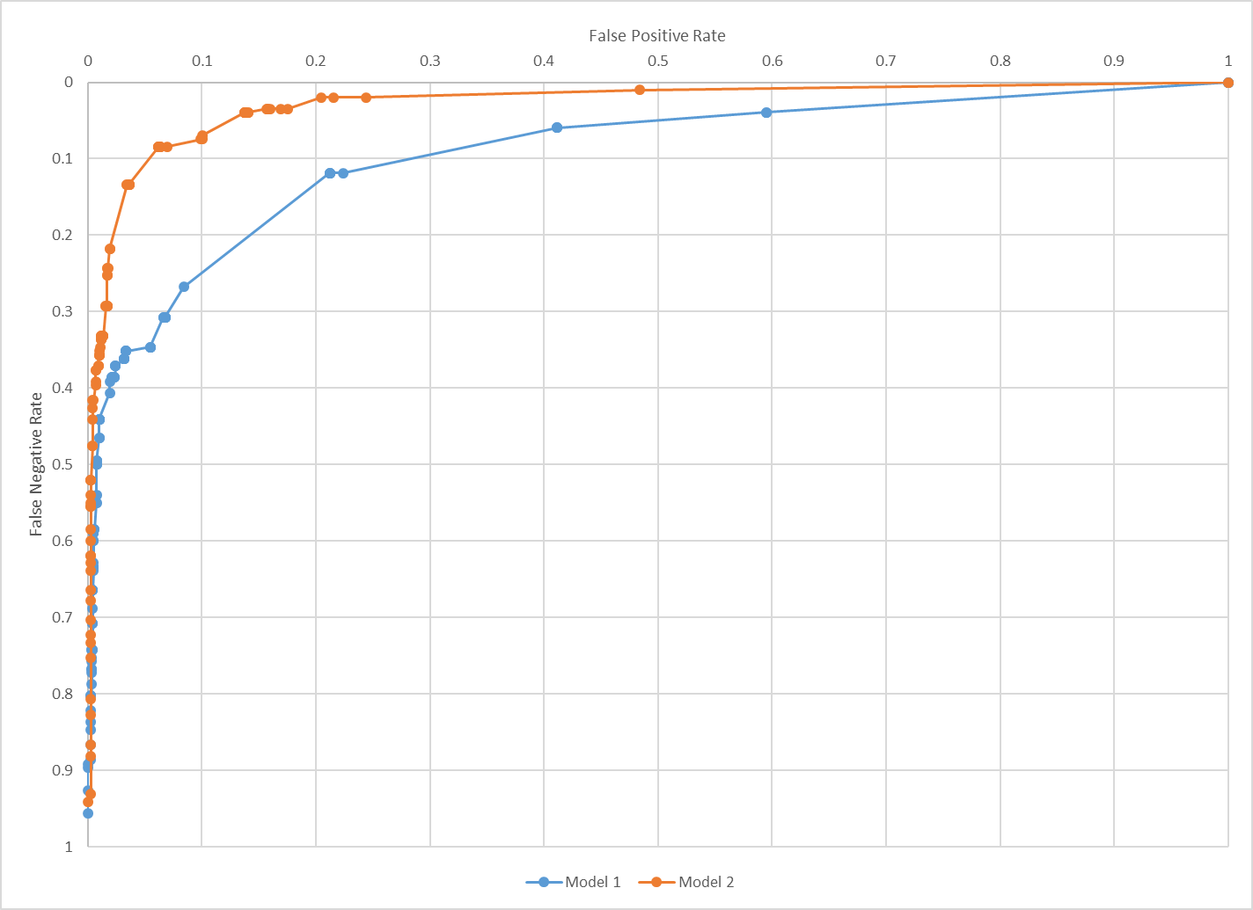
Comparing Models with ROC Curves

Slide 6
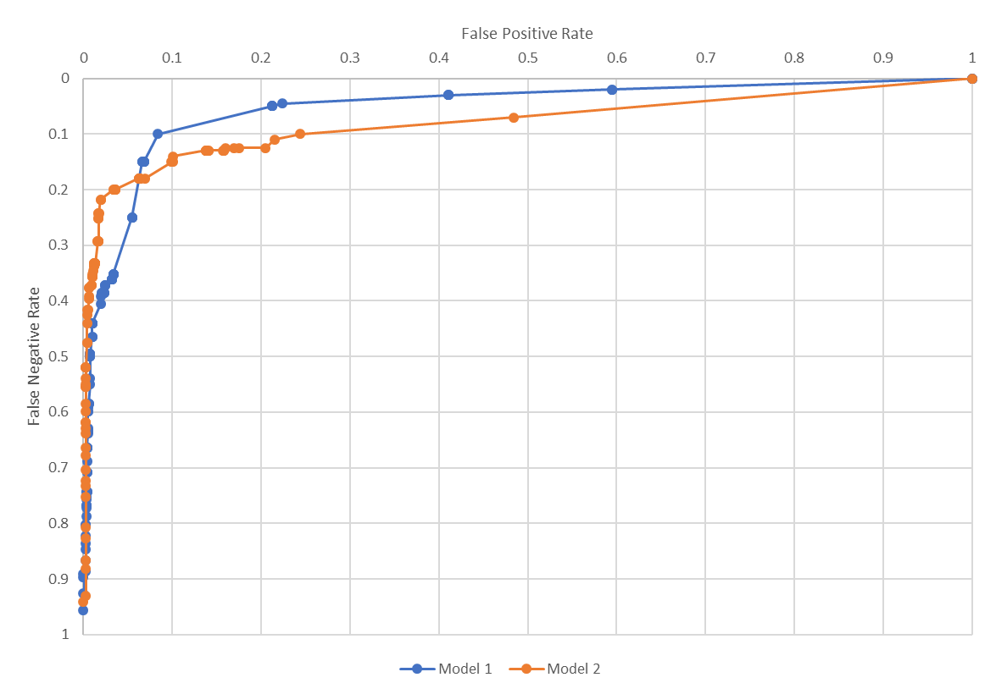
More ROC Comparisons

Slide 7
Some Common ROC Problems

Slide 8
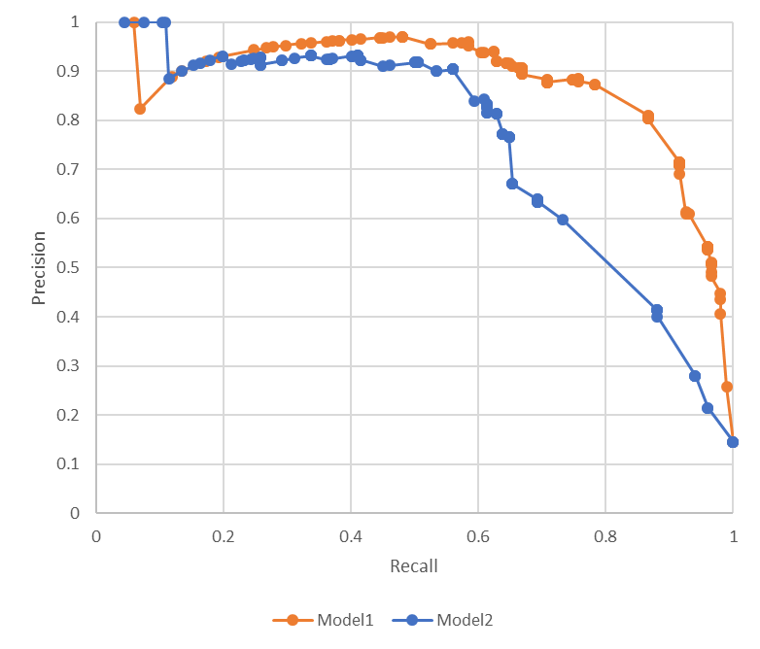
Precision Recall Curves – PR Curves
Incremental Classifications More Accurate
Everything Classified Correctly
Incremental Classifications
Less Accurate
First Set of Mistakes
Everything Classified as 1

Slide 9
Area Under Curve -- AUC
AUC ~ .97
Integrate the Area Under Curve
Perfect score is 1
Higher scores allow for generally better tradeoffs
Score of 0.5 indicates random model
Score of < 0.5 indicates you’re doing something wrong…
AUC ~ .89

Slide 10
Operating Points
Balance Mistakes for your Application
Spam needs low FP Rate
Use separate hold out data to find threshold

Slide 11
Pattern for using operating points
# Train model and tune parameters on training and validation data
# Evaluate model on extra holdout data, reserved for threshold setting
xThreshold, yThreshold = ReservedData()
# Find threshold that achieves operating point on this extra holdout data
potentialThresholds = {}
for t in range [ 1% - 100%]:
potentialThresholds[t] = FindFPRate(model.Predict(xThreshold, t), yThreshold)
bestThreshold = FindClosestThreshold(<target>, potentialThresholds)
# Evaluate on test data with selected threshold to estimate generalization performance
performanceAtOperatingPoint = FindFNRate(model.Predict(xTest, bestThreshold), yTest)
# make sure nothing went crazy…
if FindFPRate(model.Predict(xTest, bestThreshold), yTest) <is not close to> potentialThresholds[bestThreshold]:
# Problem?

